Slide 1
Improved Machine Learning based Classification Model for Early Autism Detection
T. Akter, M. I. Khan, M. H. Ali, M. S. Satu, M. J. Uddin and M. A. Moni
Presented by
Group 7
21166033 Rafeed Rahman
21366016 Riyo Hayat Khan
21366021 Dibyo Fabian Dofadar
21366035 Md. Sabbir Ahmed
22166025 Hasnat Md. Abdullah
‹#›

Slide 2
Introduction
What is ASD (Autism Spectrum Disorder)?
Lifelong neurodevelopmental disorder
Difficulties in communication, social interaction
Repetitive interests and behavioral abnormalities
Detecting ASD - Existing Methods
Quantitative Checklist for Autism in Toddlers (Q-CHAT) and Autism Quotient (AQ), uses discriminant indexing, denoted as Q-CHAT-10 and AQ-10
Recursive feature elimination and stability selection methods
Clustering-based Autism Trait Classification (CATC), semi supervised machine learning model
Rules-based machine learning (RML), detects autism traits and offers intelligent rules to explore reasons for classification
Computational Intelligence (CI), extracts feature-to-class and feature-to-feature correlations and built a predictive model, eg. Variable Analysis (VA)

Slide 3
Introduction (Continued)
Data Collection
The aim of the research work-
To investigate autism datasets with various machine learning methods
Generating better results to early detect autism
Correlation based analysis and transformation methods to manipulate datasets
This work can detect ASD at any stage of age more accurately
20 features to explore autism traits among toddlers, child, adolescent, and adults
Each dataset with 10 behavioral features
Children, adolescent, and adult datasets collected from the University of California Irvine (UCI) and toddlers dataset from Kaggle machine learning
Toddlers dataset contains 1054 samples (319 female and 735 male), the child dataset with 248 records (74 male and 174 female), 98 records of adolescent dataset where both female and male contain 49 records
609 samples of the adult dataset consists of 288 female and 321 male records

Slide 4
Data Preprocessing
These datasets were contained several missing values that were replaced by mean values. - Data imputation is done.
Also they investigated the correlation among individual variables and measured how strongly they are related. When one variable is highly correlated with other variables, it can be shown unstable classification result and one of them is needed to omit.
In the toddlers dataset, ”QChat10_Score” is highly correlated with other variables. Again, ”age_desc” and ’’result” are extremely correlated with others in the child and adolescent dataset. Consequently, ”result” is highly correlated with other much more variables in the adult dataset. Therefore, they excluded ”QChat10_Score” , ”age_ desc” , and ”result” variables from these datasets.

Slide 5
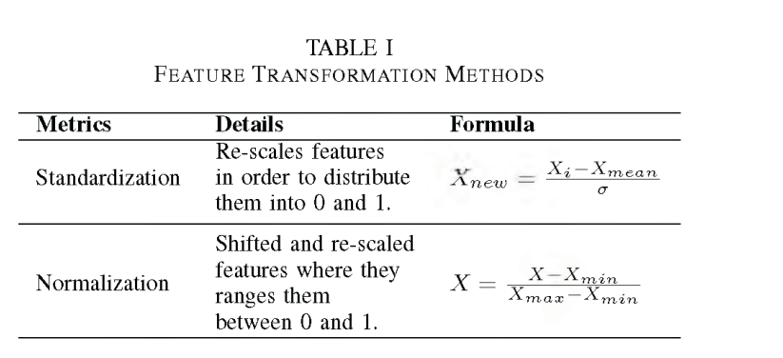
Feature Transformation
In this work, these datasets contain numerous categorical variables that alter categorical variables into a suitable format so that the performance of individual classifiers were improved. So, two feature transformation models such as standardization and normalization were employed (see Table I) into these autism datasets.
Besides, different machine learning classifiers such as Artificial Neural Network (ANN), Recurrent Neural Network (RNN), Decision Tree (DT), Extreme Learning Machine (ELM), Gradient Boost (GB), K Nearest Neighbor (KNN), Logistic Regression (LR), Multilayer Perceptron (MLP), Naive Bayes (NB), Random Forest (RF), Support Vector Machine (SVM) and XGBoost (XGB) were employed into autism datasets to explore the best performing classifier for detecting autism more accurately

Slide 6
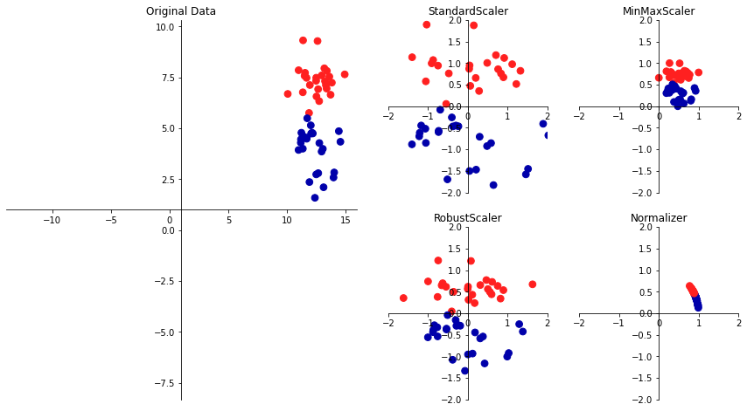

Slide 7
Evaluation Metrics
In classification approach, individual values are generated like true positive (TP), true negative (TN), false positive (FP),and false negative (FN). These values is represented in a suitable structure which is called confusion matrix.
Thus, various evaluation metrics such as accuracy, f-measure, gmean, AUC, sensitivity, specificity, fall out, and miss rate were used to verify the performance of these classifiers from these values.

Slide 8
Experimental Result
Twelve machine learning classifiers were implemented followed by a 10 fold cross validation technique using Scikit learn and Keras library
Toddlers Dataset:
All classifiers performed above 90% in all evaluation metrics
LR > MLP > RNN > ANN > XGB > GB > SVM > RF > KNN > NB > ELM > DT
Child Dataset:
Eight classifiers produce results greater than 90% and four classifiers represent performance between 85% and 90%
LR > MLP > RNN > ANN > XGB > SVM > GB > RF > ELM > DT > KNN > NB
Adolescent Dataset:
Four classifiers produce results greater than 90%, seven classifiers represent performance between 80% and 90%, and one with greater than 75%
LR > MLP > XGB > ANN > RF > SVM > RNN > GB > NB > ELM > KNN > DT
Adult Dataset:
All of the classifiers provide a performance greater than 90%
LR > ANN > MLP > SVM > RNN > XGB > GB > RF > KNN > NB > ELM > DT

Slide 9
Discussion
Data analytical procedures were used beforehand.
Higher performing ML model is proposed to detect Autism Spectrum Disorder (ASD)
Highly co-linear factors of each ASD dataset explored and scrutinized.
Evaluation metrics (accuracy, f-measure, gmean, AUC, sensitivity, specificity, fall out, and miss rate) used to compare the existing model with the previous ones.
Logistic Regression (LR) gave the best results for toddlers, children and adolescents.
Reducing highly correlated variables produced better result.

Slide 10
Conclusion & Future Works
Preprocess -> Transformed format -> Classifier (LR) -> Detection of ASD
Helpful for physician and psychiatrists in case of Behavioral Feature and Treatment Planning
Still there is no perfect screening tools for autism detection
In future, more ASD datasets are required by the authors to improve the existing model.

